Slide 1
UML to RDF
In the context of the NEN3610 – Linked Data project
Presentation for the ISO19103 revision project
Presentation available at:
https://github.com/Geonovum/NEN3610-Linkeddata/blob/gh-pages/Presentations/NEN3610-LD%20and%20ISO19103.pptx

Slide 2
Context
NEN 3610, the GeoBaseModel. The information standard for the exchange of geo-information. It prescribes UML as the formal language to specify semantics and advocates GML as technical implementation format. NEN 3610 is therefore not equiped to realize data – and semantics sharing through linked data.
ISO
ISO
ISO TC/211
INSPIRE
European practice
NEN3610
Dutch GeoBaseModel
National standards
Data exchange
IMTOP
Domain standards
IM . . .
IMMetingen
IMAER
IMWA
IMNAB
IMKAD
IMKICH
IMWE
IMGeo
IM0101
IMRO
IMLG
IMOOV
IMBRO
IMKL

Slide 3
UML-OO GeoBaseModel (NEN 3610)
RDF /Linked data
Pyramid of specialization
Silos extending common rules
Stack of profiles and extensions
Pyramid of reuse and reference
reuse and references of ontologies
Rules and semantics
international
ISO
Generic
ontologies
time, geometry, location
Rules and semantics
national
Generic functional
ontologies
Functional layer
temporal, identification
Domain models
All concepts
Centralized vocabulary
tree, road, buliding etc
Domain specifications
domain-ontologie
Subset and
reuse of concepts
Use case defines universe of discourse
Domain defines vocabulary – domain standard
The Universe is the Universe of discourse
Anybody can say anything about anything

Slide 4
Results of the product
The set bibliographic references for NEN3610
The references documents, using DublinCore vocabulary;
A glossary of NEN3610 terms;
Terms like “attribute”, “geo-object”, using SKOS vocabulary;
A taxonomy of the NEN3610 upper classes;
Terms like “Building”, “Waterway”, “Terrain”, using SKOS vocabulary;
An ontology and profile for NEN3610 models;
Classes and attributes as defined in NEN3610, using RDFS/OWL/SHACL
A set of best-practices to transform a UML model into a RDF Linked Data model.

Slide 5
Complementary use cases
UML model:
Controlled environment;
For a specific application;
Models the data in a domain;
Data exchange, data processing, data administration.
RDF / Linked Data model:
Controlled vocabulary;
Universal use in mind (open environment);
Models the ontology of the domain;
Data exchange, data processing, data administration.

Slide 6


UML – LD combination UML – LD derivation
Let’s make UML and LD interoperable

Slide 7



Universe of Discourse
(UoD)
model of
model of
UML
model
RDF
model
transformation
Building on existing knowledge:
ISO 19150-2: 2015 - Geographic information -- Ontology -- Part 2: Rules for developing ontologies in the Web Ontology Language (OWL)
INSPIRE - Guidelines for the RDF encoding of spatial data (ARE3NA)

Slide 8
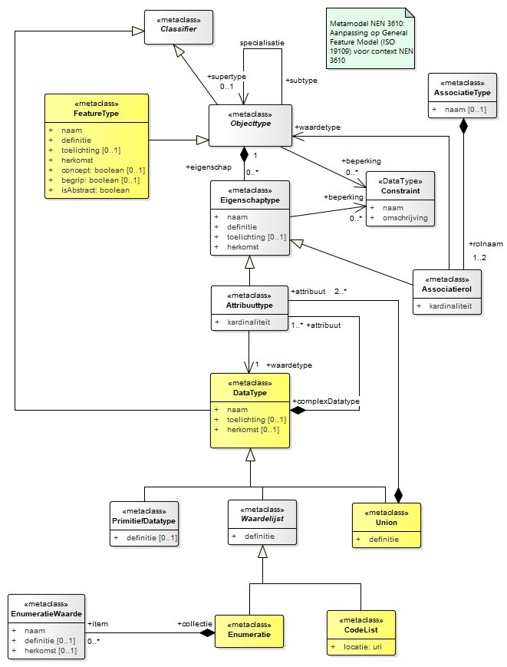
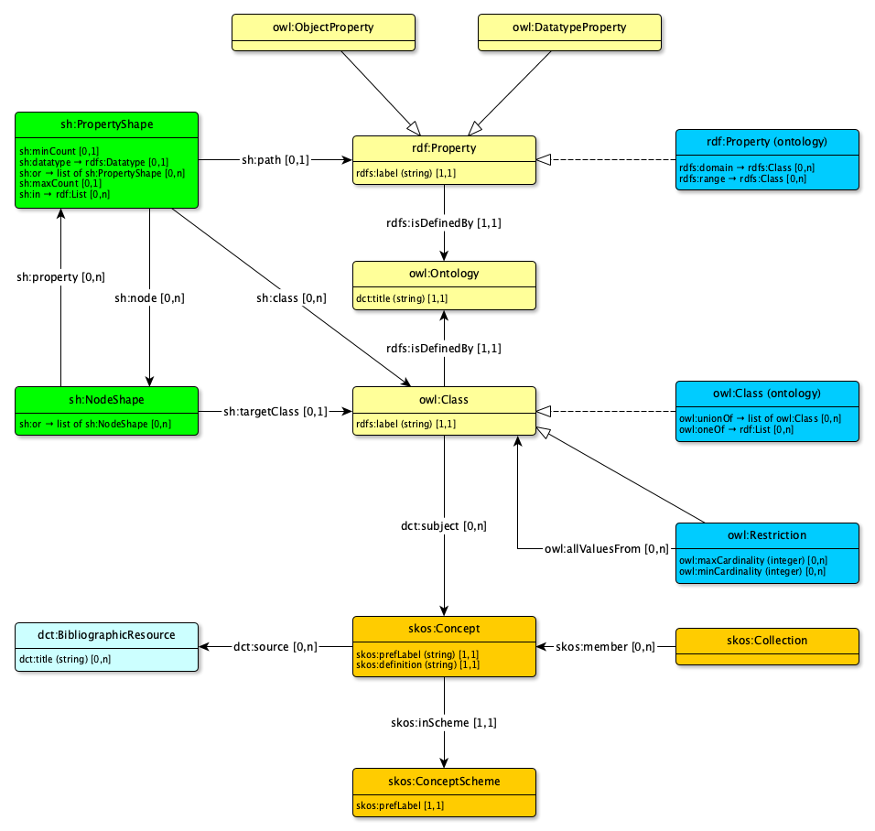
Metamodels
UML2
SKOS
SHACL
OWL/RDFS
DublinCore

Slide 9
Comparable elements
UML | Linked Data
Class | Class, Shape, Concept
Attribute | Property
Association, role | Property
Generalization | subclass
Datatype | Datatype
Cardinality | minCount & maxCount
Enumeration | PropertyShape (range restriction)
Union | or / oneOf

Slide 10
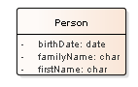
Differences
UML uses “class” to:
Denote the class of things in the domain;
Describes the meaning (definition) of that class;
Specifies the information constructs for that class
The metamodel conforms to the UML philosophy: a construct for a specific purpose

Slide 11
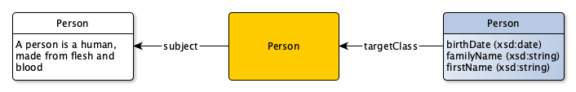
Differences
Linked Data uses:
“owl:class” to denote the class of things in the domain;
“skos:concept” to describe the meaning (definition) for that class;
“shacl:shape” to specifies the information constructs for that class.
The metamodel conforms to the LD philosophy: linking excisting vocabularies

Slide 12
Differences
@prefix rdfs: <http://www.w3.org/2000/01/rdf-schema#>.
@prefix skos: <http://www.w3.org/2004/02/skos/core#>.
@prefix owl: <http://www.w3.org/2002/07/owl#>.
@prefix sh: <http://www.w3.org/ns/shacl#>.
@prefix xsd: <http://www.w3.org/2001/XMLSchema#>.
@prefix exc: <http://example.org/concept/>.
@prefix exo: <http://example.org/ontology#>.
@prefix exs: <http://example.org/shapegraph#>.
exc:Person a skos:Concept;
skos:prefLabel “Person”@en;
skos:definition “A person is a human made, from flesh and blood”@en;
.
exo:Person a owl:Class;
rdfs:label “Person”@en;
dct:subject exc:Person;
.
exs:Person a sh:NodeShape;
sh:targetClass exo:Person;
sh:name “Person”;
sh:property [
sh:path exo:birthDate;
sh:datatype xsd:date;
];
sh:property [
sh:path exo:familyName;
sh:datatype xsd:string;
];
sh:property [
sh:path exo:firstName;
sh:datatype xsd:string;
];
.
UML has no canonical serialization (despite XMI)
Linked Data has no canonical notation.

Slide 13
Differences
@prefix rdfs: <http://www.w3.org/2000/01/rdf-schema#>.
@prefix skos: <http://www.w3.org/2004/02/skos/core#>.
@prefix owl: <http://www.w3.org/2002/07/owl#>.
@prefix sh: <http://www.w3.org/ns/shacl#>.
@prefix xsd: <http://www.w3.org/2001/XMLSchema#>.
@prefix exc: <http://example.org/concept/>.
@prefix exo: <http://example.org/ontology#>.
@prefix exs: <http://example.org/shapegraph#>.
exc:Person a skos:Concept;
skos:prefLabel “Person”@en;
skos:definition “A person is a human made, from flesh and blood”@en;
.
exo:Person a owl:Class;
rdfs:label “Person”@en;
dct:subject exc:Person;
.
exs:Person a sh:NodeShape;
sh:targetClass exo:Person;
sh:name “Person”;
sh:property [
sh:path exo:birthDate;
sh:datatype xsd:date;
];
sh:property [
sh:path exo:familyName;
sh:datatype xsd:string;
];
sh:property [
sh:path exo:firstName;
sh:datatype xsd:string;
];
.
UML has no canonical serialization (despite XMI)
Linked Data has no canonical notation.

Slide 14
Differences
@prefix rdfs: <http://www.w3.org/2000/01/rdf-schema#>.
@prefix skos: <http://www.w3.org/2004/02/skos/core#>.
@prefix owl: <http://www.w3.org/2002/07/owl#>.
@prefix sh: <http://www.w3.org/ns/shacl#>.
@prefix xsd: <http://www.w3.org/2001/XMLSchema#>.
@prefix exc: <http://example.org/concept/>.
@prefix exo: <http://example.org/ontology#>.
@prefix exs: <http://example.org/shapegraph#>.
exc:Person a skos:Concept;
skos:prefLabel “Person”@en;
skos:definition “A person is a human made, from flesh and blood”@en;
.
exo:Person a owl:Class;
rdfs:label “Person”@en;
dct:subject exc:Person;
.
exs:Person a sh:NodeShape;
sh:targetClass exo:Person;
sh:name “Person”;
sh:property [
sh:path exo:birthDate;
sh:datatype xsd:date;
];
sh:property [
sh:path exo:familyName;
sh:datatype xsd:string;
];
sh:property [
sh:path exo:firstName;
sh:datatype xsd:string;
];
.
UML has no canonical serialization (despite XMI)
Linked Data has no canonical notation.

Slide 15
Differences
@prefix rdfs: <http://www.w3.org/2000/01/rdf-schema#>.
@prefix skos: <http://www.w3.org/2004/02/skos/core#>.
@prefix owl: <http://www.w3.org/2002/07/owl#>.
@prefix sh: <http://www.w3.org/ns/shacl#>.
@prefix xsd: <http://www.w3.org/2001/XMLSchema#>.
@prefix exc: <http://example.org/concept/>.
@prefix exo: <http://example.org/ontology#>.
@prefix exs: <http://example.org/shapegraph#>.
exc:Person a skos:Concept;
skos:prefLabel “Person”@en;
skos:definition “A person is a human made, from fle
.
exo:Person a owl:Class;
rdfs:label “Person”@en;
dct:subject exc:Person;
.
exs:Person a sh:NodeShape;
sh:targetClass exo:Person;
sh:name “Person”;
sh:property [
sh:path exo:birthDate;
sh:datatype xsd:date;
];
sh:property [
sh:path exo:familyName;
sh:datatype xsd:string;
];
sh:property [
sh:path exo:firstName;
sh:datatype xsd:string;
];
.
UML has no canonical serialization (despite XMI)
Linked Data has no canonical notation.

Slide 16
Differences
@prefix rdfs: <http://www.w3.org/2000/01/rdf-schema#>.
@prefix skos: <http://www.w3.org/2004/02/skos/core#>.
@prefix owl: <http://www.w3.org/2002/07/owl#>.
@prefix sh: <http://www.w3.org/ns/shacl#>.
@prefix xsd: <http://www.w3.org/2001/XMLSchema#>.
@prefix exc: <http://example.org/concept/>.
@prefix exo: <http://example.org/ontology#>.
@prefix exs: <http://example.org/shapegraph#>.
exc:Person a skos:Concept;
skos:prefLabel “Person”@en;
skos:definition “A person is a human made, from flesh and blood”@en;
.
exo:Person a owl:Class;
rdfs:label “Person”@en;
dct:subject exc:Person;
.
exs:Person a sh:NodeShape;
sh:targetClass exo:Person;
sh:name “Person”;
sh:property [
sh:path exo:birthDate;
sh:datatype xsd:date;
];
sh:property [
sh:path exo:familyName;
sh:datatype xsd:string;
];
sh:property [
sh:path exo:firstName;
sh:datatype xsd:string;
];
.
UML has no canonical serialization (despite XMI)
Linked Data has no canonical notation.

Slide 17
Differences
@prefix xsd: <http://www.w3.org/2001/XMLSchema#>.
@prefix exc: <http://example.org/concept/>.
@prefix exo: <http://example.org/ontology#>.
@prefix exs: <http://example.org/shapegraph#>.
exc:Person a skos:Concept;
skos:prefLabel “Person”@en;
skos:definition “A person is a human made, from flesh and blood”@en;
.
exo:Person a owl:Class;
rdfs:label “Person”@en;
dct:subject exc:Person;
.
exs:Person a sh:NodeShape;
sh:targetClass exo:Person;
sh:name “Person”;
sh:property [
sh:path exo:birthDate;
sh:datatype xsd:date;
];
sh:property [
sh:path exo:familyName;
sh:datatype xsd:string;
];
sh:property [
sh:path exo:firstName;
sh:datatype xsd:string;
];
.
UML has no canonical serialization (despite XMI)
Linked Data has no canonical notation.

Slide 18
IM

Slide 20

Universe of Discourse
(UoD)
model of
model of
UML
model
RDF
model
#1
RDF
model
#2
autom. transformation
manual refinement
conforms to
conforms to
derived from
RDF
GeoBase
metamodel
XSD
data
structuur
conforms to
Input
Input
conforms to
XML
data
Automated conversion
RDF
data
input
output

Slide 21
Challenges when transforming UML models to RDF
There is no 1 to 1 mapping possible between UML information models and “good” RDF ontologies for linked data
What is a “good” RDF ontology for linked data?
One that results in linkable data!
Recognizable/relatable things
Why is this a problem?
UML information models model data, RDF ontologies model semantics
UML information models have implicit semantics
UML information models often reflect some degree of denormalization
UML information models often model registrations of real world objects, whereas RDF ontologies model real world objects “directly”

Slide 22
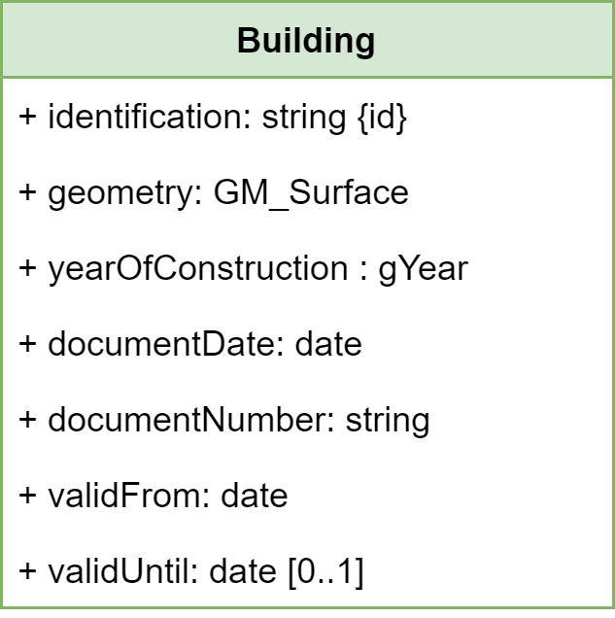
Example 1/4
Normal form

Slide 23
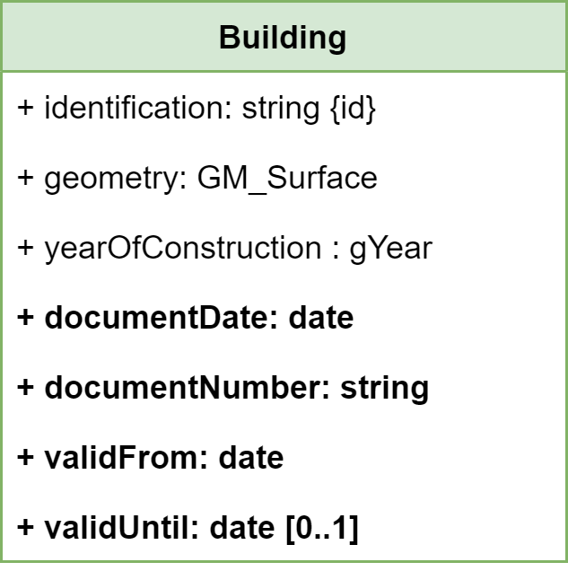
Example 1/4
Normal form

Slide 24
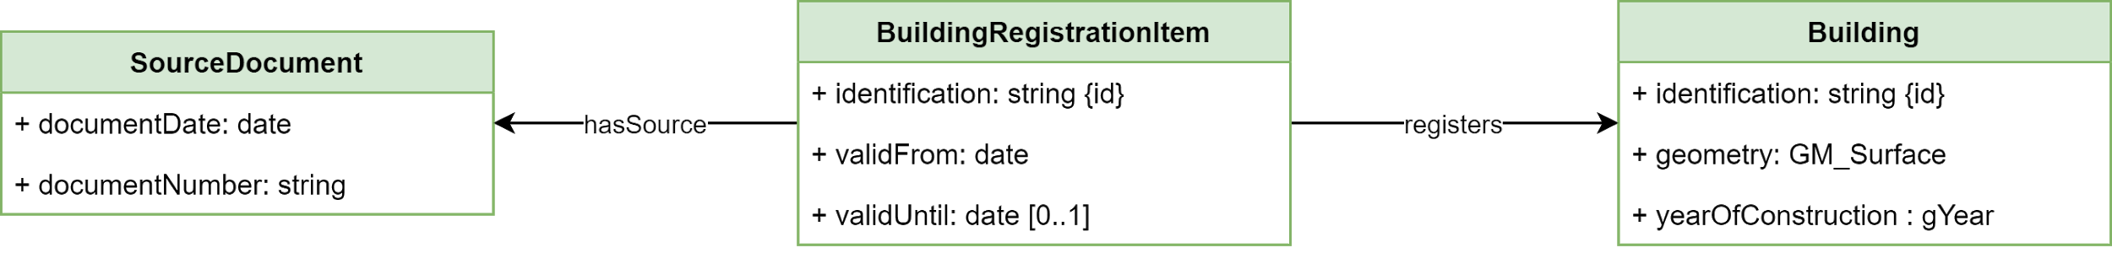
Example 1/4
Normal form

Slide 25

Example 2/4
Predicate vs Property
“Paul works for Geonovum”
subject
predicate
object

Slide 26
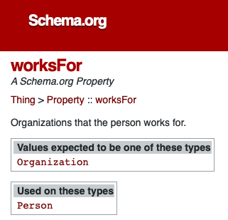
Example 2/4
Predicate vs Property
Paul
worksFor
Geonovum
@prefix schema: <http://schema.org/>.
@prefix ex: <http://example.org/>.
ex:Paul schema:worksFor ex:Geonovum.

Slide 27
Example 2/4
Predicate vs Property
Paul
worksFor
Geonovum
is a
Person
@prefix schema: <http://schema.org/>.
@prefix ex: <http://example.org/>.
ex:Paul schema:worksFor ex:Geonovum.
ex:Paul a schema:Person.

Slide 28
Example 2/4
Predicate vs Property
Paul
worksFor
Geonovum
is a
is an
Person
Organization
@prefix schema: <http://schema.org/>.
@prefix ex: <http://example.org/>.
ex:Paul schema:worksFor ex:Geonovum.
ex:Paul a schema:Person.
ex:Geonovum a schema:Organization.

Slide 29
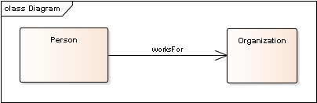
Example 2/4
Predicate vs Property
Paul
worksFor
Geonovum
is a
is an
Person
Organization
@prefix schema: <http://schema.org/>.
@prefix ex: <http://example.org/>.
ex:Paul schema:worksFor ex:Geonovum.
ex:Paul a schema:Person.
ex:Geonovum a schema:Organization.

Slide 30
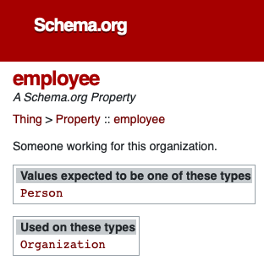
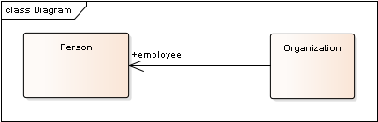
Example 2/4
Predicate vs Property
Geonovum
employee
Paul
is an
is a
Organization
Person
@prefix schema: <http://schema.org/>.
@prefix ex: <http://example.org/>.
ex:Geonovum schema:employee ex:Paul.
ex:Paul a schema:Person.
ex:Geonovum a schema:Organization.

Slide 31
Example 2/4
Predicate vs Property
“Geonovum has employee Paul”

Slide 32
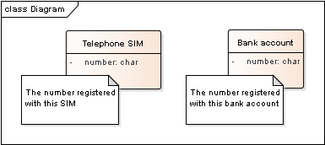
Example 3/4
Attributes vs Predicates
ex:aTelephoneSim ex:number ”00331234567”.
ex:aBankAccount ex:number “DE05 1002 0500 0003 2873 00”.
ex:number a rdfs:Property.

Slide 33
Example 3/4
Attributes vs Predicates
“So I could call my bank, using my bank account number???”
“Yes please, wire that money to my telephone number!”
ex:aTelephoneSim ex:number ”00331234567”.
ex:aBankAccount ex:number “DE05 1002 0500 0003 2873 00”.
ex:number a rdfs:Property;
rdfs:domain ex:TelephoneSIM;
rdfs:range xsd:string;
.
ex:number a rdfs:Property;
rdfs:domain ex:BankAccount;
rdfs:range xsd:string;
.

Slide 34
Example 3/4
Attributes vs Predicates
shape:TelephoneSIM a sh:NodeShape;
sh:targetClass ex:TelephoneSIM;
sh:property [
sh:path ex:number;
sh:datatype xsd:string
];
.
shape:BankAccount a sh:NodeShape;
sh:targetClass ex:BankAccount;
sh:property [
sh:path ex:number;
sh:datatype xsd:string
];
.
ex:aTelephoneSim ex:number ”00331234567”.
ex:aBankAccount ex:number “DE05 1002 0500 0003 2873 00”.
ex:number a rdfs:Property.
It is possible, using SHACL (structure), but maybe it is better to have richer semantics, using different terms (bankAccountNumber, telephoneNumber)

Slide 35
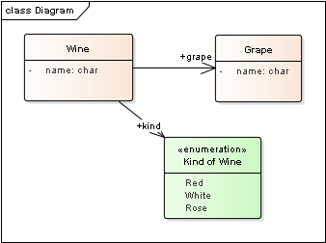
Example 4/4
Subclass vs Enumeration

Slide 36
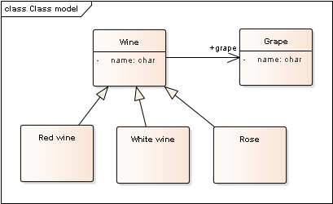
Example 4/4
Subclass vs Enumeration

Slide 37
Automatic translation of UML to RDF ontology?
It is possible to create a (syntactically) correct translation;
It is not possible to create a valid translation
Semantic information is (almost always) missing in the original model
Human interpretation is necessary.
Approach taken:
Standardised automatic translation as a starting point.
The SHACL vocabulary is the missing link between UML and RDF.
Describe “best practices” and “pitfalls” for the human touch.

Slide 38
Take away message
UML en Linked Data models can represent the same knowledge about the domain;
Most value is delivered from automatic transformation at the data level (M0), this requires a valid translation between the models (model level, M1);
Care should be taken to the mindset of the modeller.
Full automatic translation at the model level (M1) is only possible if this mindset is made explicit in the model.
For example: using tagged values, stereotypes, etc…

